Slide 1
Introduction to the FaaS Model

Slide 2
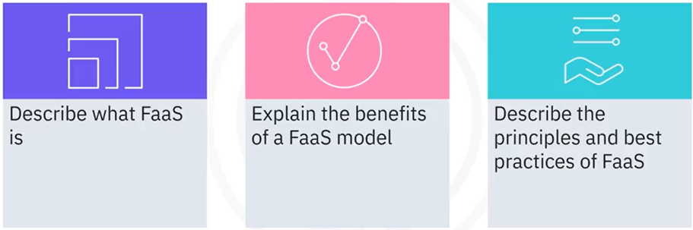
What you will learn

Slide 3
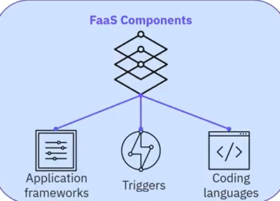
What is FaaS
• Function as a Service
FaaS Components
• Cloud-computing without
complex infrastructure

Slide 4

FaaS characteristics
• Subset of serverless computing
• Creates applications as functions
• Deploys on hybrid and on-premise
• Stateless
• Includes functions that execute in
milliseconds and are instantaneously
scalable
• Lightweight and decoupled
• Billed on consumption and execution not on
server size

Slide 5
FaaS benefits
• Divides server into functions
• Focus more on code
• Reduce time-to-market
• Pay for what you use
• Functions are stateless, small, independent pieces of code
• Scale automatically and independently as required
• Scale down automatically, if demand drops
• Inherent high availability
• Spread across regions and availability zones

Slide 6
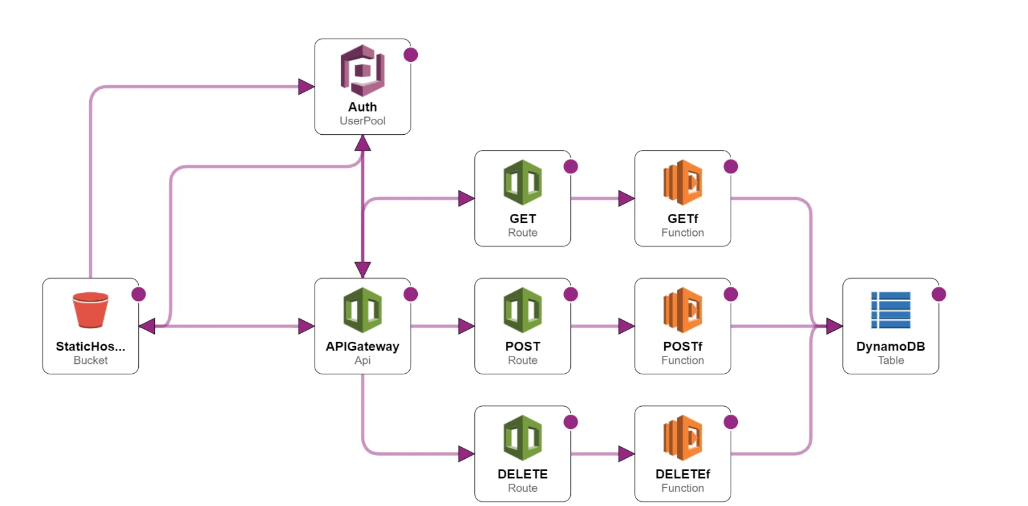
How serverless stack components work

Slide 7
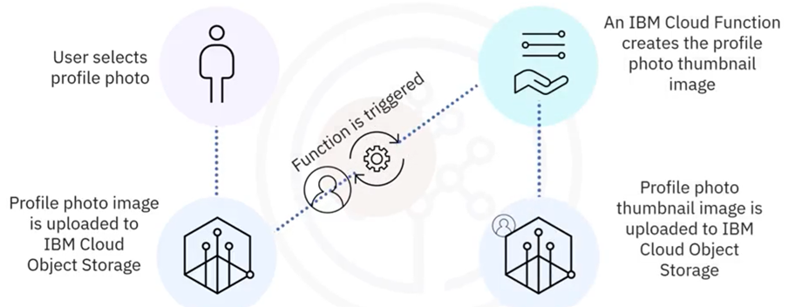
Functions in action

Slide 8
FaaS principles and best practices
• Make each function perform only one action
• Make your code scope limited, efficient and
lightweight
• Functions load and execute quickly
• Avoid function chaining
• Too many functions increases cost
• Limit dependencies on third-party libraries
• Slows down initialization
• Makes them harder to scale

Slide 9
Managed FaaS providers
• Amazon - AWS Lambda
• Google Cloud Functions
• Microsoft - Azure Functions
• IBM Cloud Functions
• Red Hat - OpenShift Cloud Functions
• Others...

Slide 10
Self-managed FaaS
• Fission
• Fn Project
• Knative
• OpenFaaS

Slide 11
Recap
In this video, you learned that:
• FaaS is a type of cloud-computing service that allows you to execute code
in response to events without a complex infrastructure
• FaaS is a subset of serverless computing that creates applications in the
form of multiple functions
• FaaS can be deployed on hybrid clouds as well as on-premises
environments
• FaaS is billed on the time taken to run functions and not on server
instance sizes
• A serverless stack is comprised of FaaS, Baas, and an API Gateway
• There are several different managed and self-managed FaaS platforms to

